Slide 1
Can They Hit?
Exploring which teams and players have a better On Base Percentage (OBP).

Slide 2
The ‘Problem’
Exploring how we can maximize a teams value and success in winning through various player attributes:
Players Value
Players OBS VS AVG
Can this information help determine Trade Options?
Future outcome of the teams success and what to focus on stat wise on individual players.

Slide 3
The data provided is from FanGraphs - Major Leagues Leaderboards, utilizing data that can be found in a Sabermetric Library (Offense Terms).
The data provided does require any cleaning since there is a clean data of record keeping.

Slide 4
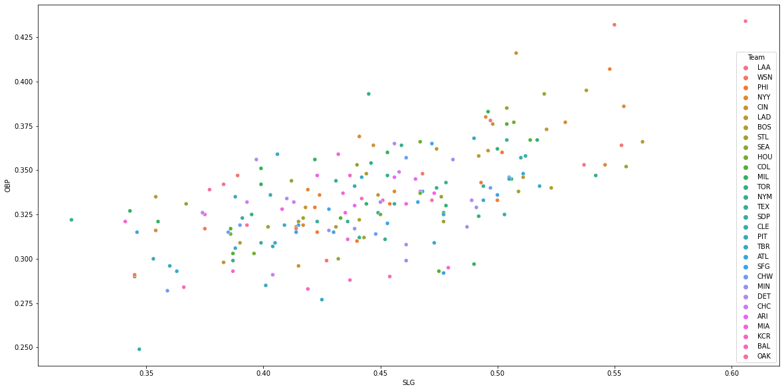
From 2015 to 2021 the Los Angeles Angels have the best OBP to SLG comparison and yet they have not made it to the World Series since 2002, which they won. So the question is; if a team can hit, can they go all the way?

Slide 5
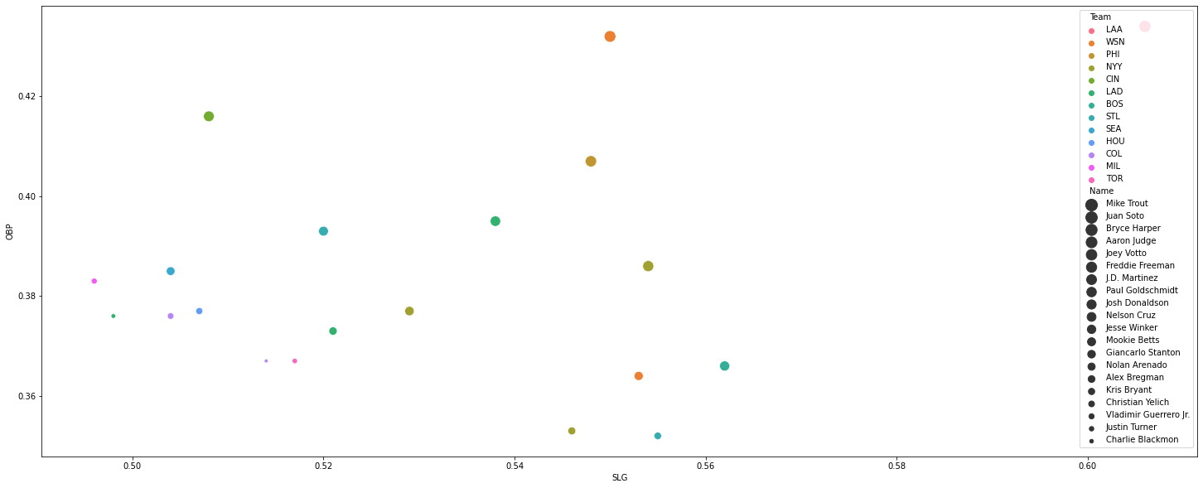
It's not doubt that Mike Trout has the best On Base Percentage to Slugging comparison but we can see that the young slugger Juan Soto is putting up amazing numbers as well and could possibly gain the same outcome later on especially since the young Juan Soto has only been in the majors since 2018 whereas Mike Trout has been in the Majors since 2011.

Slide 6
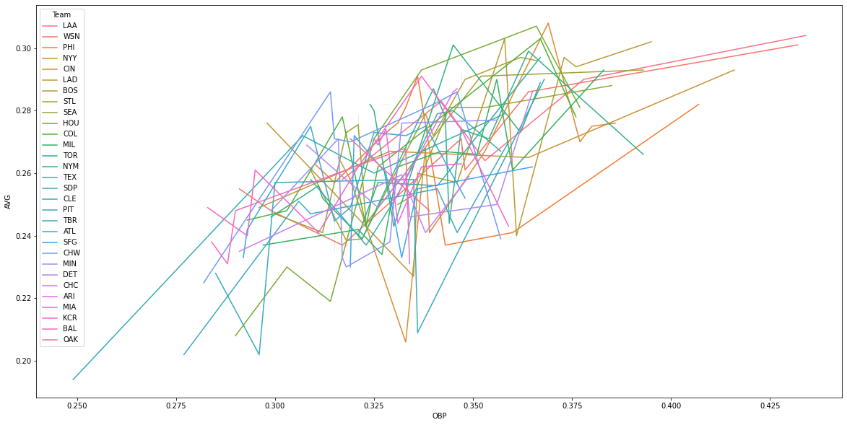
In respect to both Juan Soto and Mike Trout we see that they are major contributors to their teams OBP.

